Slide 1
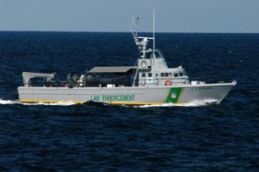
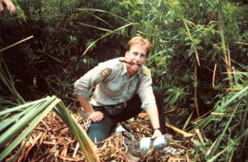
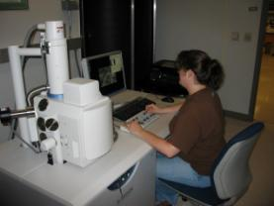
Florida Fish and Wildlife Conservation Commission
Notes:
Donny:
Introduction.
Thanks for having us.
Director Collins sends his regrets
We will do our best to inform you

Slide 2


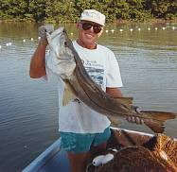
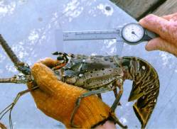
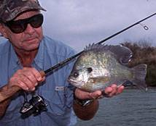
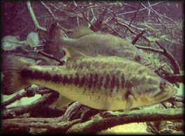
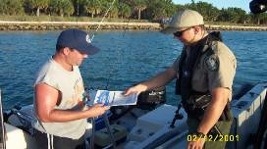
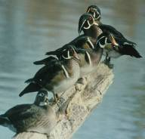
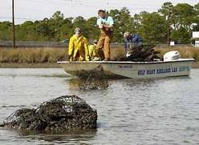

FWC Mission
Managing fish and wildlife resources for their long-term well-being and the benefit of people.
Notes:
Donny
Managing fish and wildlife resources for their long-term well-being and the benefit of people.

Slide 3
FWC Commission
7 Commissioners - appointed by the Governor for 5-year staggered terms, confirmed by the Senate
  Kathy Barco, Chairman
  Ken Wright, Vice Chair
  Ron Bergeron
  Richard Corbett
  Aliese “Liesa” Priddy
  Charles Roberts
  Brian Yablonski
Notes:
Donny
7 Commissioners - appointed by the Governor for 5-year staggered terms, confirmed by the Senate
They meet five times each year to hear staff reports, consider rule proposals, and conduct other Commission business.

Slide 4

FWC Organizational Structure
Commissioners
Executive Director
Executive Director
Divisions:
Hunting and Game Management
Habitat and Species Conservation
Freshwater Fisheries
Management
Marine Fisheries Management
Fish and Wildlife Research Institute
Law Enforcement
Offices:
Finance & Budget Licensing and Permitting
Information Technology Inspector General
Legal Legislative Affairs
Human Resources Planning and Policy Coordination
Community Relations Public Access and Wildlife Viewing
Notes:
Joyce:
As Donny mentioned, we are going to keep this short and sweet. I think it will be beneficial to highlight the organizational structure of the FWC. Directly under the Commissioners, our Executive Director is Mr. Nick Wiley. The agency has six divisions:
Hunting and Game Management manages and conserves game wildlife such as turkeys, deer and certain waterfowl.
Habitat and Species Conservation manages Florida’s lands, waters and animals to maintain stable or increasing populations with the focus being on non game and imperiled species such as panthers, manatees and sea turtles.
Freshwater Fisheries manages and preserves freshwater fisheries. This includes over 7,700 lakes and over 250 freshwater fish species statewide.
Marine Fisheries manages and preserves marine fisheries in state waters. The FWC manages and protects more than 500 species of marine fish.
Fish and Wildlife Research Institute – This is the research arm of the FWC. They provide information to the resource managers in the four divisions I just told you about.
Law Enforcement protects Florida’s natural resources and people. FWC officers have full police powers with statewide jurisdiction. In addition, all FWC officers are considered U.S. law enforcement officers. Their arrest powers cover all 50 states as authorized by the National Marine Fisheries’ Services/NOAA. Certain FWC officers are also empowered by the Department of Homeland Security and their IDs would state that they are “Customs Officers”.
The Florida Fish & Wildlife Conservation Commission has 10 offices. Shortly, Ms. Erin Rainey will explain about our Licensing and Permitting Section.

Slide 5
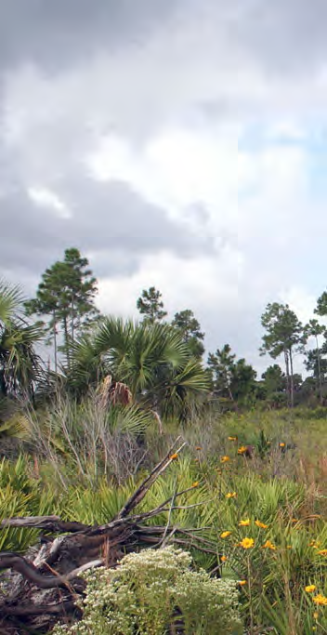

What Is FWC’s Purpose –
Managing Resources
Managing Florida’s Fish and Wildlife Populations and their Habitats
Ensure sustainable populations
Protect habitat
Make science-based decisions
Notes:
Donny
Managing Resources – Our approach to managing resources is…
To ensure the sustainability of Florida’s fish and wildlife populations
We ensure there is sufficient habitat to support healthy and diverse fish and wildlife populations
We use the best available science to guide management decision-making

Slide 6
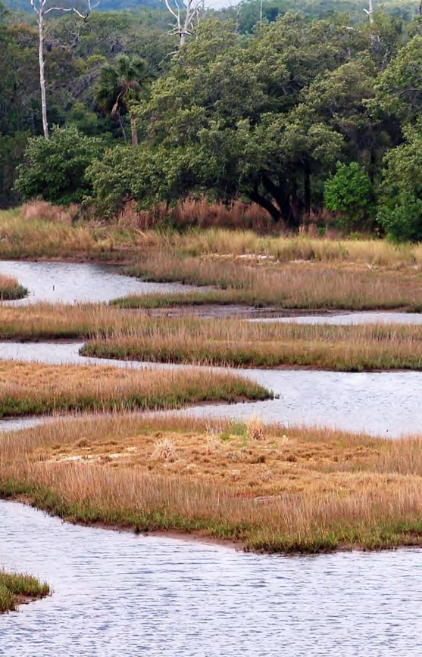
What Is FWC’s Purpose –
Providing Opportunities
Ensuring Hunting, Fishing, Boating and Wildlife-viewing Opportunities
Maintain quality opportunities for human enjoyment
Use minimal regulations
Enhance human safety
Notes:
Joyce:
Providing Opportunities - In order to provide and enhance opportunities for the public to enjoy Florida’s fish and wildlife resources the FWC works to…
Ensure that Florida’s fish and wildlife populations are able to sustain hunting, fishing and wildlife viewing
We use the minimal amount of regulations to manage sustainable fish and wildlife populations
We work to enhance the safety of those who hunt, fish, boat, and view fish and wildlife

Slide 7
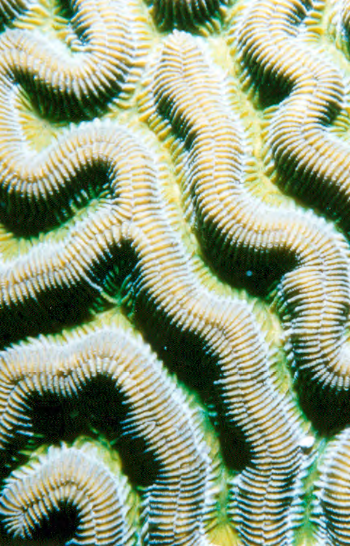
What Is FWC’s Purpose –
Sharing Responsibility
Sharing Responsibility for Conservation and Management with an emphasis on developing conservation values in our youth
Create the next generation that cares
Engage stakeholders and coordinate partnerships
Provide conservation information
Increase conservation opportunities
Notes:
Donny
Sharing Responsibility – The FWC recognizes the importance of getting citizens involved with conservation.
We engage youth to help create the next generation that cares about fish and wildlife conservation
We further engage stakeholders and coordinate partnerships to promote conservation
We provide information to promote the importance of conserving fish and wildlife and their habitats
We work to increase opportunities for the public, especially youth, to practice conservation

Slide 8
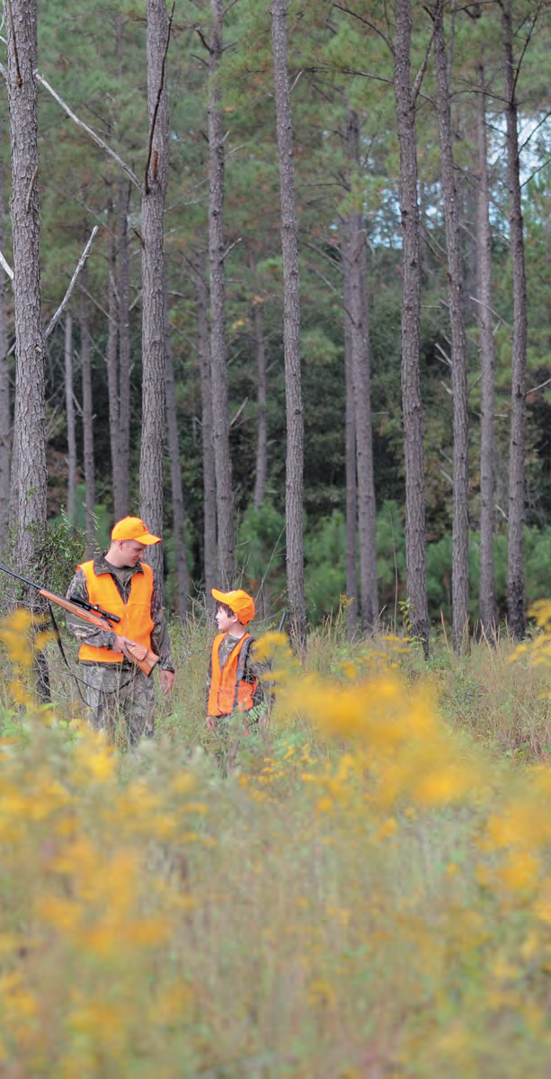
What Is FWC’s Purpose –
Benefiting Community
Increasing Community Involvement
Continue commitment to benefit community and the economy
Provide safety and emergency response support
Promote understanding of social and economic benefits
Notes:
Joyce:
With regard to Benefiting the Community – The FWC is here to serve the people of Florida.
We are committed to benefiting the community and enhancing the economy through our work
We provide resources and support for the safety of citizens and visitors and for emergency responses
We promote an understanding of the social and economic benefits of hunting, fishing, boating and wildlife viewing

Slide 9
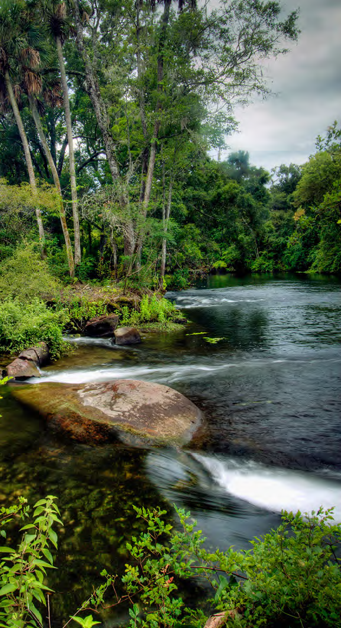
What Is FWC’s Purpose –
Managing Our Organization
Managing an Effective and Responsive Organization
Provide excellent service
Maintain efficient workforce
Ensure adequate resources
Increase public understanding
Notes:
Donny
Managing Our Organization – to efficiently manage our organization we strive to…
Provide excellent and consistent service to Florida’s citizens and visitors
We maintain a highly efficient workforce with a goal of continuous improvement
We ensure adequate resources are available to meet and exceed customer needs
We increase the public’s understanding and support of FWC’s mission

Slide 10
Creating the Next Generation that Cares
Getting Youth Involved in the Outdoors
Youth Conservation Centers Network
Get Outdoors Florida
Kids Fishing Clinics
Outdoors Adventure Camps
Youth and Family Hunting Opportunities
National Archery in Schools Program
Junior Birder Program
Project WILD
Notes:
Joyce:
Creating the next generation that cares:
Today's children are increasingly disconnected from nature.
They devote nearly eight hours a day to media.
We know that kids who do not directly engage in the outdoors are less likely to be interested in conservation.
FWC engages our youth through the programs listed here.
At this time, it is my pleasure to introduce Ms. Erin Rainey, from our Office of Licensing & Permitting.

Slide 11



What Is the Tax Collector’s Relationship with FWC
License and Permit Sales Location
  Sell all Recreational Hunt/Fish Licenses & Permits
  Some Sold Only at Tax Collector’s Offices
    Charter Boat/Captain, Pier, Recreational Vessel
    Tarpon Tag (only at some TC Offices)
    Lifetime, if do not have FL DL or ID
    Military Gold Sportsman
    Sell Auto Tags & Decals Supporting FWC
    Conserve Wildlife, Manatee, Panther, Sea Turtles, Fishing, Oceans, Springs Auto Tags
    Manatee and Sea Turtle Decals
Notes:
Tax Collectors act as recreational hunting and fishing license sales agents. Selling all the different recreational hunting and fishing licenses and permits offered by FWC.
Those licenses that require the holder of the license or permit to meet additional qualifications that need to be verified or when there is a need to provide a physical tag are sold only at Tax Collector Offices.

Slide 12
FY 2010-2011 License Sales by Sales Channel
License | Quantity | % | License Sales | FWC Fees | Tax Collector Fees | Agent Fees
Major Chains
Chain Stores Total: | 991,972 | 59.58% | $16,157,193 | $649,073 | $321,515 | $402,435
INTERNET
INTERNET Total: | 657,780 | 26.80% | $12,518,559.20 | $485,134.80 | $0.00 | $0.00
TELEPHONE
TELEPHONE Total: | 161,260 | 6.57% | $3,204,283.80 | $164,506.20 | $0.00 | $0.00
TAX COLLECTORS
TAX COLLECTORS Total: | 217,114 | 8.85% | $5,316,467.50 | $28,954.50 | $134,381.00 | $0.00
OTHER Retailers
ALL OTHERS Total: | 425,946 | 17.36% | $7,985,521.00 | $317,656.50 | $157,156.00 | $187,059.50
Grand Total: | 2,367,642 | 100.00% | $44,867,855.80 | $1,732,921.20 | $696,556.50 | $673,735.00
Notes:
Tax Collectors are compensated in two ways for providing their services, directly for each license or Management Area permit that they sell and indirectly through each license or Management Area permit sold in their County by a sales agent.
Tax Collectors process 8.85% of the license and permits statewide.
Tax Collectors got $134,381.00 in direct payment for the licenses they processed in their offices in FY 2010-11.
Tax Collectors got $478,671.00 in payments for licenses processed by retailers in their counties in FY 2010-11.
379.352
5) In addition to any license or permit fee, the sum of $1.50 shall be charged for each license or management area permit, except for replacement licenses, to cover the cost of issuing such license or permit.
(6)(a) The fee established pursuant to subsection (5) shall be distributed as follows:
1. For each hunting license and freshwater fishing license sold by a tax collector, including the combination freshwater fishing and hunting license, the sportsman's license, and the gold sportsman's license, a tax collector may retain $1.00.
2. For each management area permit sold by a tax collector, a tax collector may retain $1.00.
3. For each saltwater fishing tag and saltwater fishing license sold by a tax collector, including the combination saltwater fishing and freshwater fishing license and the combination saltwater fishing, freshwater fishing, and hunting license, a tax collector may retain $1.50.
4. For licenses and management area permits sold by subagents, a tax collector may retain 50 cents for each license sold in the tax collector's county.

Slide 13
Legislative Change from 2011-12
Printed Recreational Saltwater Fishing Regulations No longer Funded
  A limited number will be printed for July/January delivery based on advertising sales
  There will be no additional copies
  This funding will NOT be restored next year
  Hunting and Freshwater Fishing Regulations are being printed in same quantities as in past
Notes:
While FWC uses an advertising-based model to cover much of the costs associated with printing the hunting and fishing regulation booklets, the agency has continued to subsidize the printing and distribution effort. FWC’s funding for the printed copies of the recreational saltwater fishing regulations was eliminated by the 2011 Florida legislature. This reduction was one of many made in an attempt to lower FWC agency costs and achieve a balanced budget state-wide. Unfortunately, the result is that FWC will no longer be able to provide printed copies of the recreational saltwater fishing regulations after the initial July and January distributions.

Slide 14
Legislative Changes for 2012-13
Blue crab soft shell commercial fee reduction from $250 to $125
Repeal of Florida Wildlife magazine (Print Version)
Lobster trap theft penalty increase
Hunter education mentor option modification
Clarification of fishing license requirements for scuba divers/scuba diving charter boats
Notes:
Funding for the printed version of the Florida Wildlife magazine was ended with the start of the 2011-12 fiscal year. This removed the statutory language to produce the magazine. An online electronic version will be available at MyFWC.com
The one time exemption for a person born on or after June 1, 1975 to have successfully completed a hunter safety course before purchasing a hunting license has been removed. A person can now get the exemption each time they apply for a hunting license. Any person with this exemption must hunt under the supervision of, and in the presence of, a person 21 years or age or older who is licensed to hunt or who is exempt from licensing requirements.
Dive boat operators do not need to have a Charter license, but if they don't all passengers that are spear fishing or lobstering must be licensed.
379.354 (7) (f) The operator of a vessel that carries scuba divers for a fee, either directly or indirectly, maintains the appropriate vessel license under this subsection based upon the number of persons the vessel is licensed to carry and the applicable permits, the individual scuba divers engaging in taking or attempting to take saltwater products are not required to obtain individual fishing licenses or any applicable permits. However, if the operator of such a vessel does not have the appropriate license and applicable permits, the individual scuba divers engaging in taking or attempting to take saltwater products must have individual fishing licenses and any applicable permits.

Slide 15
Commission Updates for 2012-13
TC’s Issuing Temporary Disability Licenses
Recreational Licensing Issuance Services (RLIS) replaces Total Licensing System (TLS) for issuing recreational licenses.
  Florida Contractor : Brandt Information Services, Inc
  Oct. 1,2012 Implementation Date
Notes:
Tax Collectors, if they wish to, will be able to issue a temporary 30 day Disability License to customers who provide the proper supporting documentation – this will be for both new and renewing applicants.
RLIS contract with Brandt Information Services, Inc of Tallahassee Florida. Who teamed with Verizon, HP, WiseOutlook and ColorPress to be selected for the RLIS project.
Implementation date is projected as October 1, 2012

Slide 16
RLIS: What’s Changing?
Look and feel – simpler, larger font, easier to use
DL swipe option – speeds processing, reduces keying, reduces errors
Better Accounting Reporting
Better Messaging
Notes:
While the process of issuing a licenses will remain basically the same, the following will be different;
Look and feel - simpler; larger font; easer to use
- DL swipe option - speeds processing; reduces keying; reduces errors
For FL DL will fill in demographics even if not on our DL file yet
For non FL DL will fill in demographics as best as it can
- Increased Accounting Reporting, you will be able to see all the reports for your office that FWC can see
- Better Messaging

Slide 17
RLIS: What’s Changing?
Thermal Printers – faster, more reliable, networkable
No yellow paper receipt
New License Stock
Modification of this years Limited Entry/Quota Application Schedule due to RLIS implementation
Notes:
While the process of issuing a licenses will remain basically the same, the following will be different;
- Thermal Printers – faster; more reliable (i.e. no ink ribbon), work better in a network environment
- No yellow paper receipt (not possible with thermal printer) improved reports will replace
- Colored Print Stock (light blue) with White Logo
Add Notes on Limited Entry/Quota Application Schedule changes effects

Slide 18
RLIS: What Isn’t Changing?
High Quality License stock
Vendor Help Desk
OLP support

Slide 19
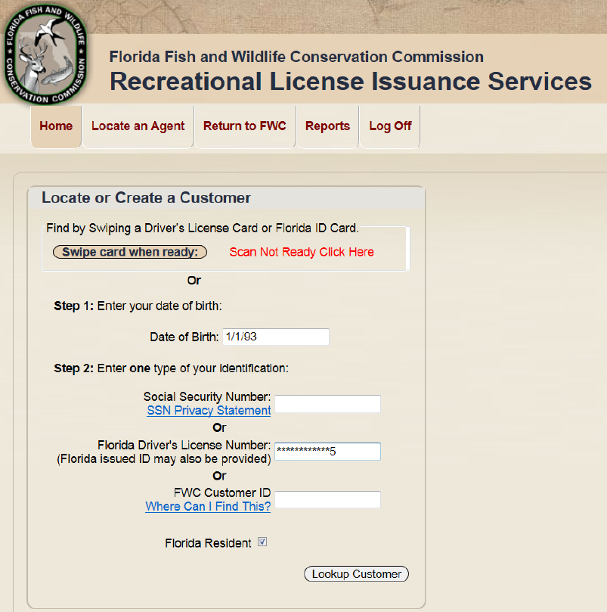
RLIS: Begin License Sale Screen
Notes:
For those who want them, Brandt will provide a keyboard equipped with a swipe reader to expedite locating a customer record in the system. We are also working toward being able to read and pre-populate demographic information from Non-Florida driver licenses or ID cards.

Slide 20
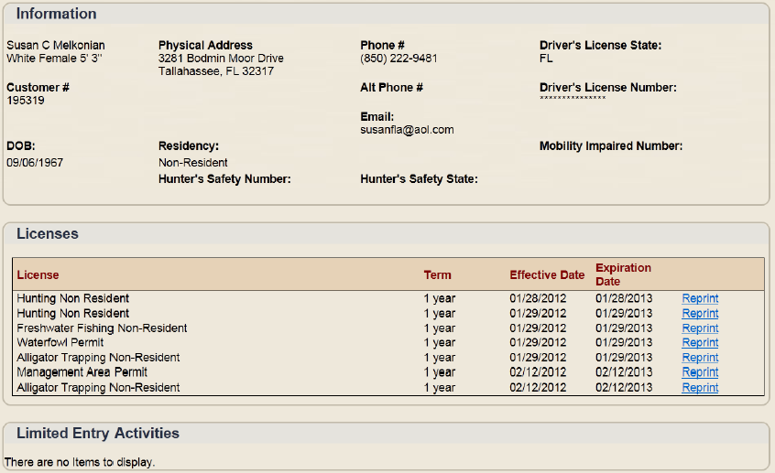
RLIS: Customer Screen
Notes:
This is the landing screen. From here clerks can easily view and update the customer’s address and contact information, view current licenses and limited entry activities (including applications and awards for limited entry and quota permits), and quickly reprint or renew a customer’s licenses or permits.

Slide 21
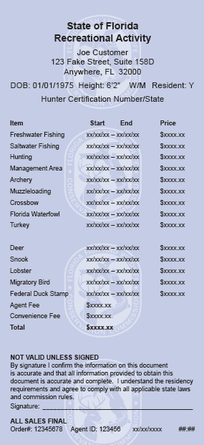
New License Stock (Draft)

Slide 22
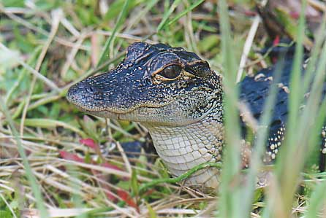
Questions ???

